Slide 1


Slide 2

30 Days Python Master Class
Day1 : Python
Time: 6.00 PM IST
Free Registration

Slide 3
Python Master Class
Handbook

Slide 4
NANDHINI.S
Exp: 5 Yrs
Expert in
Python Developer on Machine Learning
Deep learning with computer vision
Matlab – Image Processing
Autonomous Car design using ROS with LIDAR
Language – Python , Java , HTML ,CSS.
Tools – ANACONDA NAVIGATOR, JUPYTER NOTEBOOK,
GOOGLE COLAB.
Graduation : BE – ECE | 2011

Slide 5
Pantech?
Educational Equipment Manufacturer
IoT, AI, Robotics,Autonomous Robot
Microprocessor/Microcontroller
DSP,VLSI, Embedded System
Power Electronics & Drives, Fuel Cell Trainer Kit
Renewable Energy Lab, Electric Vehicle Lab
Technical Training
DIY Project

Slide 6

What is Master Class ?
👍 This is the 30 Days Industrial Learning Activity.
👍 Its Online YouTube Live Class
👍 If you Invest 45 minutes daily, U will become Master in Data Science
👍 You will get FREE E-Certificate
Webinar Participation Certificate
“Learning is the beginning of wealth.
Searching & Learning is where the miracle process all begins.” …………….Jim Rohn

Slide 7
Our Vision
Help 10 Million Students to Learn the Technology in Easy Way

Slide 8

Associate Partner for this Master Class
https://apssdc.in/home/

Slide 9
What U will Learn from 30 Days Data Science & Analytics Master Class

Slide 10
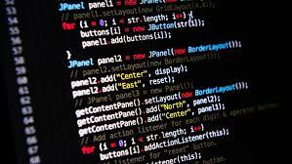
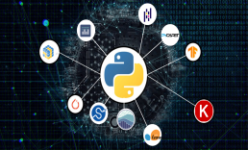


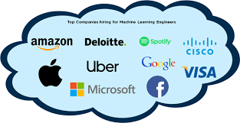
Python Learning Plan
01
02
03
04
05
Library
Python
Analytics
Analytics
Industry Project
Introduction To Python and Python Data Structures
Pandas
Numpy
MatplotLib
Cborn, SKLearn Lib
Collab
Distribution
Visualization
Aggregation
Statistics
Distribution Function
Project Building

Slide 11
Day wise Learning Plan
Day -1 : Introduction to Python
Day -2: Python – Tools|Syntaxes & Data Structures
Day -3: Python – Dictionaries,Date and Time
Day -4: Python – MySql
Day -5: Pandas library – Introduction
Day -6: Pandas library – Data Structures
Day -7: Numpy library – Introduction
Day -8: Numpy library – Array Manipulations, Mathematical Functions
Day -9: Matplotlib , Histogram Using Matplotlib | I/O With Numpy
Day -10: Matplotlib Library - Introduction , Pyplot API | Types Of Plots
Day -11: Seaborn Library
Day -12: SKLearn Library
Day -13: Python – Date and Time , Data Wrangling.
Day -14: Python – Data Cleansing
Day -15: Python – Word Tokenization , Stemming and Lammetization.

Slide 12
Day wise Learning Plan
Day -16: Python – Data Visualization
Day -17: Python – Statistical Analysis
Day -18: Python – Types Of Distribution
Day -19: Python – Correlation ,Chi-Square Test , Linear Regression
Day -20: Keras library – Introduction.
Day -21: Stock Price Prediction With Machine Learning LSTM RNN
Day -22: People’s behaviour in chat message using NLP NLP
Day -23: Gaming In Python
Day -24: Chatbot creation in Python NLP
Day -25: Electricity Price Prediction Using ML Random Forest Regressor
Day -26: Diamond Price Prediction Using Python Linear Regression
Day -27: Book Recommendation System KNN
Day -28: Image Classification Using CNN CNN
Day -29: Titanic Survival Analysis Using ML Logistic Regression
Day -30: Blockchain in Python

Slide 13
List of Projects for Demo in YouTube Live
Stock Price Prediction With Machine Learning
People’s behaviour in chat message using NLP
Gaming In Python
Chatbot creation in Python
Electricity Price Prediction Using ML
Diamond Price Prediction Using Python
Book Recommendation System
Image Classification Using CNN
Titanic Survival Analysis Using ML
Blockchain in Python
All Projects in Jupyter Notebook

Slide 14
What you will get from this Free 30 Days Master Class?
You can attend YouTube Live Class
Free E-Certificate ( WEBINAR PARTICIPATION CERTIFICATE)

Slide 15
How to mark your Attendance in YouTube Live Class?
Ans : During the Live Class, organizer will post Google Form link in Live Chat. The Participants should submit the from on daily basis. Minimum 25 Days Attendance is Required to get Free Master Class Participation Certificate.
Note : The Link will be available during the Live. From the LIVE Class date, the live video will get removed from the YouTube in 3 days.

Slide 16
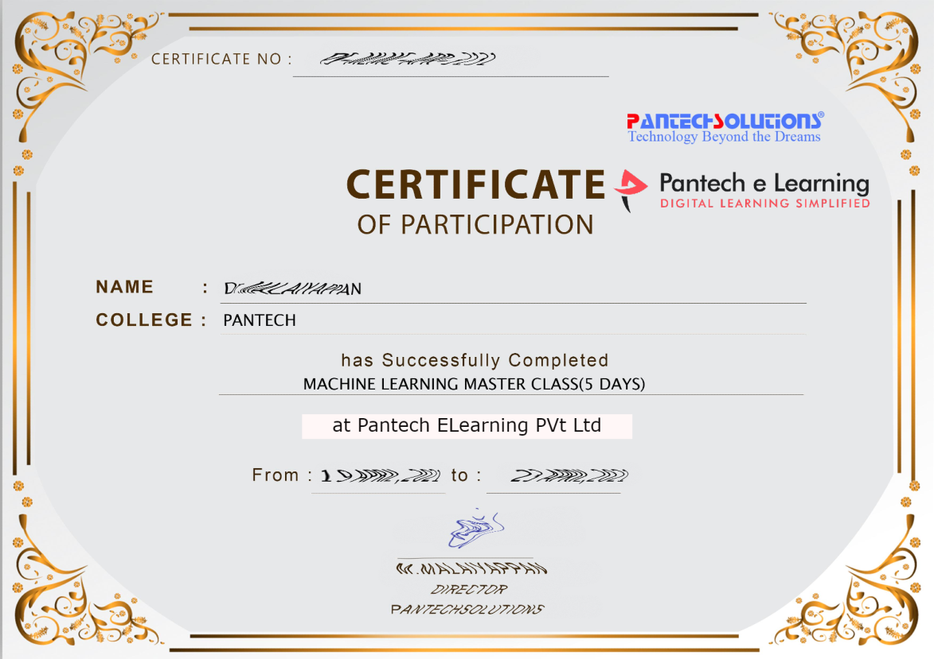

Sample Webinar Participation Certificate?

Slide 17
https://www.pantechelearning.com/data-science-master-class/
On Demand
You can get chance to apply 1 Month Internship on Data Science & Analytics Master Class

Slide 18
What is Internship????
Learn
Practice
Verify
Get Certified
Grow

Slide 19
Free Master Class DSA | 1 Month Internship on DSA
Master Class Participation Certificate | Internship Completion Certificate
Minimum 25 Class should attend YouTube Live | Recorded Class Link will be provided. – LMS Portal Access
YouTube Live Mandatory | Your Choice. You can attend Live or else You can watch Recorded Class in LMS Portal
All Projects Demo class in YouTube Live | Step by Step Video Explanation Content in LMS Portal
Access : 3 Days | VIP WhatsApp Group Support
 | You Can Download All PPTs
 | 4 Nos of Hackathon Class in Zoom Live. The Recording also will be provided
 | You Can Download All Project Files
 | Mentor will guide you to finish 10 Projects
 | Access : 60 Days

Slide 20
Pantech will make you to Create 10 Projects in Data Science & Analytics in 30 Days
Objective of this 30 Days Master Class

Slide 21
1 Month Internship in Data Science
INTERNSHIP E-Certificate(30Days Internship on Data Science Engineering)
Highly organized Video content
Download All Files
Download PPTs
Assignments
Flexible Time.
Access Period: 60Days from the date of payment

Slide 22
What You Will Get???
Complete Project Files
30 Days Learning Activity
Data Science Core Concepts
10 + Projects
Project PPT
Spatial Data Science For Covid-19 Disease Prediction
Parkinson’s Disease Prediction-XGBoost Classifier
House Price Prediction-Random Forest Regression
Customer Segmentation Using ML-K-Means Clustering
Home Loan Prediction-Decision Tree Classifier
Spam Classification-NLP
Hand Written Digit Recognition Using Python-CNN
Churn Prediction-Deep Learning
Crop Yield Prediction
Ground water level prediction
Video Class Access for 2 Months
Get chance to Enroll 1-Month Internship on demand

Slide 23
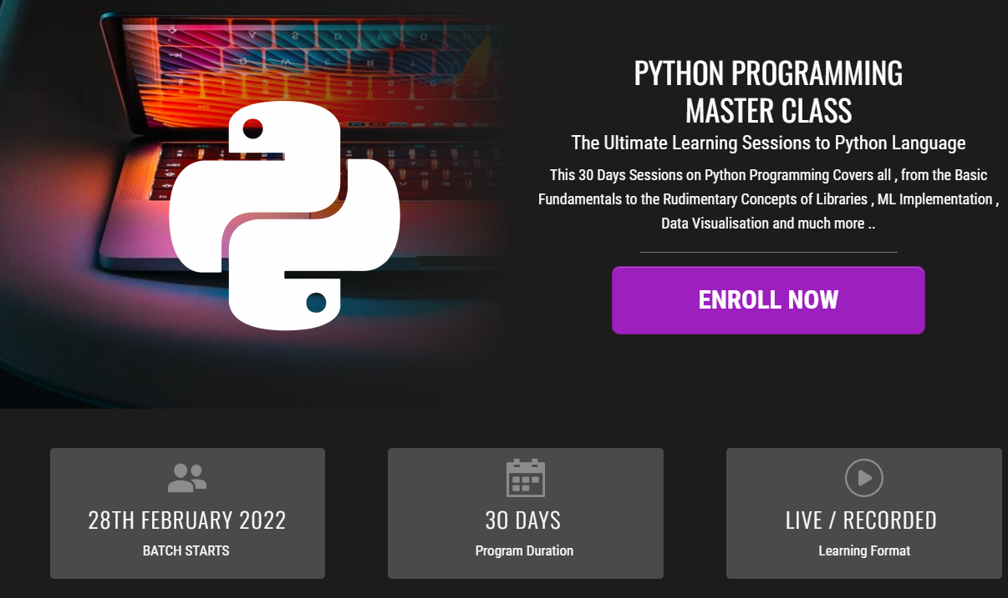
How to join in 1 month Internship
https://www.pantechelearning.com/pymc-internship/
Coupon Code: PYMC

Slide 24
What is a program ?

Slide 25
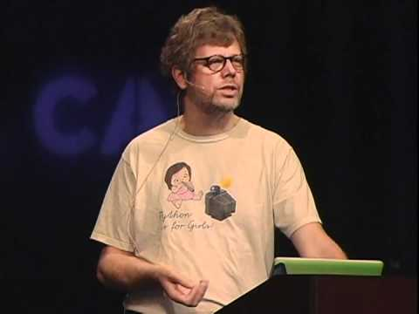
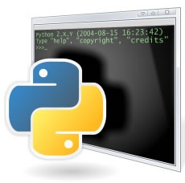

History
Guido van Rossum
At National Research Institute for Mathematics and Computer Science in Netherland.

Slide 26
Introduction
Python is :
High-level programming language.
Fast to learn and fast to develop application.
Available for many platforms.
Implement complex logic with very few lines of code.

Slide 27
Two kind of program processes:
Interpreters
Compilers

Slide 28
INTERPRETER
Input | It takes a single line of code or instruction at a time.
Output | It does not produce any intermediate object code.
Working mechanism | Compilation and execution take place simultaneously.
Speed | Slower
Memory | It requires less memory as it does not create intermediate object code.
Errors | Displays error of each line one by one.
Error detection | Easier comparatively

Slide 29
COMPILERS
Input | It takes an entire program at a time.
Output | It generates intermediate object code.
Working mechanism | The compilation is done before execution.
Speed | Comparatively faster
Memory | Memory requirement is more due to the creation of object code.
Errors | Display all errors after compilation, all at the same time.
Error detection | Difficult

Slide 30
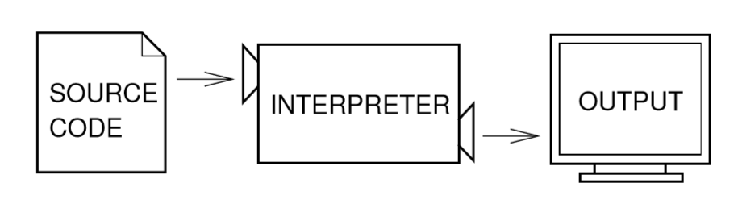
Interpreters

Slide 31
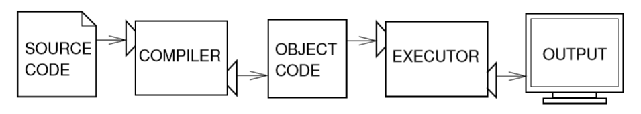
Compilers

Slide 32
PYTHON 2 VS. PYTHON 3
Python 2 is legacy, Python 3 is the present and future.
Python 3 was released in 2008.
Python 3 don’t have enough libraries.
That’s why python 2 is present and still ON.

Slide 33
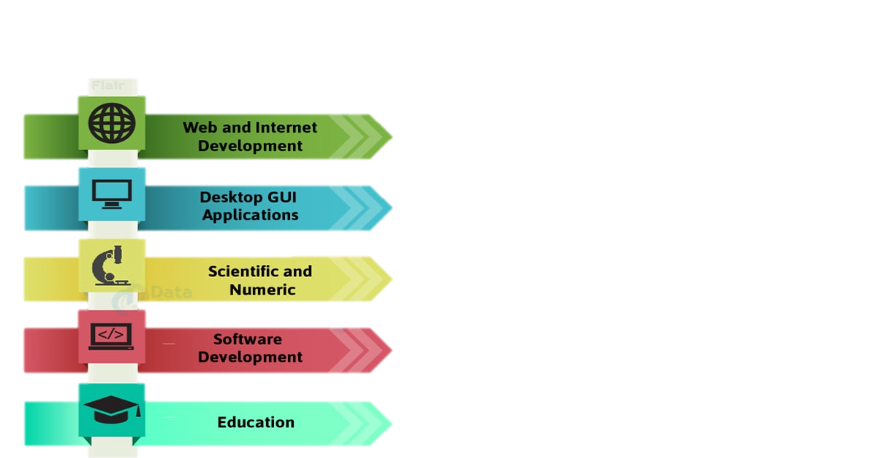
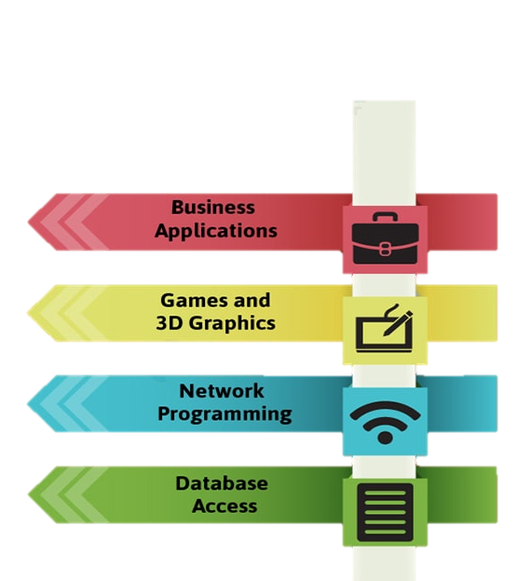
APLLICATION

Slide 34
Data type
A=10
B=10.0
C=“hello”
D=‘C’

Slide 35
Numbers
Conversion Function
float()
int()
long()
>>> int(4.5)
4
>>> float(6)
6.0

Slide 36
operators

Slide 37
Arithmetic Operators
Operators | Operations
+ | Addition
- | Subtraction
* | Multiplication
/ | Division
% | Modulus
** | Exponentiation

Slide 38
Python special Variable _ (underscore)
>>> a=5
>>> a
>>> _+ 5
10
type() function
>>> type(2)
>>>type(2.0)

Slide 39
Number Formatting
Format Specifier | Description
%d | Integer
%F | Floating point number
%s | String
%c | Character
%ld | Long Number
>>> a = 10
>>> print “a=%d” % (a)
a=10

Slide 40
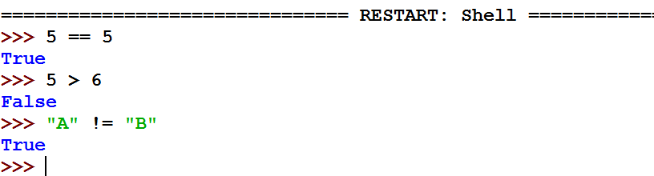
Relational operator
Basically used for while condition check
Operator | Description
== | Equal to
!= | Not Equal to
> | Greater than
>= | Greater than equal to
< | Less than
<= | Less than equal to

Slide 41
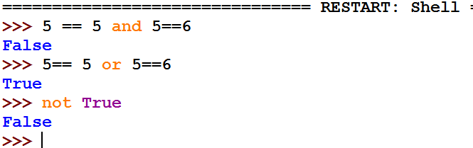
Logical operators
Operator | Description
and | Used to check when both the condition are true.
or | Used to check when either of the condition is true.
not | Negate

Slide 42
swap two numbers without using a temporary variable

Slide 43
Swap without variables
x = 10
y = 5
# Code to swap 'x' and 'y‘
# x now becomes 15
x = x + y
# y becomes 10
y = x - y
# x becomes 5
x = x – y

Slide 44
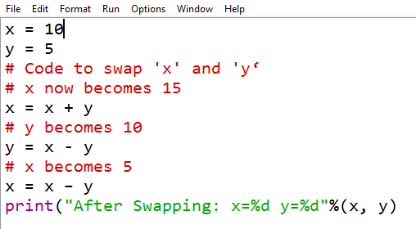
Swap without variables

Slide 45
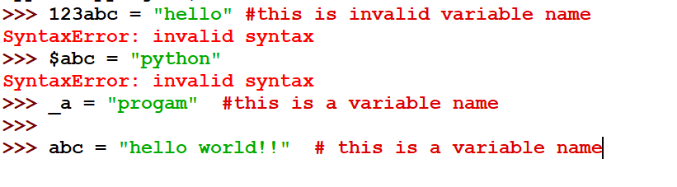
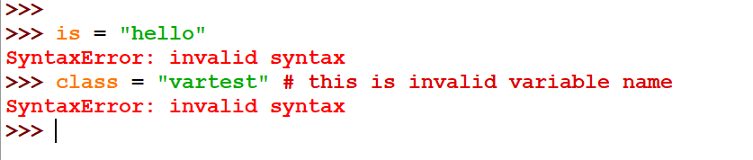
Rules for naming the variable
It cannot be a reserve keyword

Slide 46
String

Slide 47
Strings
In C….?
Memory of a string
Assigning a string variable
Reading string
String operations
----→big story…!

Slide 48
Python String
can be expressed in single quote or double quote
>>> a =‘pantech’
>>> b= “proed”
Operations on strings
>>> ‘Hello’ + ‘ ’ + ‘world !!’
>>> ‘Hello’ * 4

Slide 49
Escape Sequences
Escape Sequences | Description
\n | New line character
\t | Horizontal tab
Triple Quoted String
>>> para = “”“
… This is line one
… National Flower id ‘Lotus’
… “”“
>>> print para

Slide 50
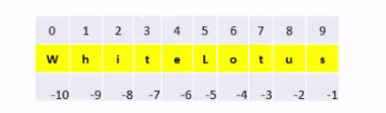
String Slicing

Slide 51
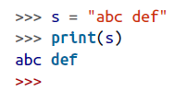
String operations in PY

Slide 52
>>> s = "name\tplace\npantech\tT-nagar"
>>> print(s)
name place
pantech T-nagar
>>>

Slide 53
Concatenating (Joining) Strings
>>> s1 = "abc"
>>> s2 = "def"
>>> s = s1 + s2
>>> print(s)
abcdef
>>>

Slide 54
Is it fine
>>> "abc" + 23
Traceback (most recent call last):
File "<stdin>", line 1, in <module>
TypeError: Can't convert 'int' object to str implicitly

Slide 55
This works fine
>>> "abc" + str(23)
'abc23'
>>>

Slide 56
Converting Numbers to Strings
>>> str(123)
'123'
>>>

Slide 57
Converting Strings to Numbers
>>> int("-123")
-123
>>>
>>> float("00123.45")
123.45
>>>

Slide 58
& some more conversions
>>> int("1001", 2)
9
>>>
>>> int("AFF0", 16)
45040
>>>

Slide 59
Find the Length of a String
>>> len("abcdef")
6
>>>

Slide 60
Find the Position of One String Inside Another
>>> s = "abcdefghi"
>>> s.find("def")
3
>>>

Slide 61
Extracting Part of a String
>>> s = "abcdefghi"
>>> s[1:5]
'bcde'
>>>
>>> s[:5]
'abcde'
>>>
>>> s = "abcdefghi"
>>> s[3:]
'defghi'
>>>

Slide 62
Replacing One String of Characters with Another Inside a String

Slide 63
>>> s = “wait wait wait untill u succeed"
>>> s.replace(“wait", “work")
‘work work work untill u succeed '
>>>

Slide 64
Converting a String to Upper- or Lowercase

Slide 65
For example, to convert aBcDe to uppercase, you would use:
>>> "aBcDe".upper()
'ABCDE'
>>>
To convert it to lowercase, you would use:
>>> "aBcDe".lower()
'abcde'
>>>

Slide 66
Conditions

Slide 67
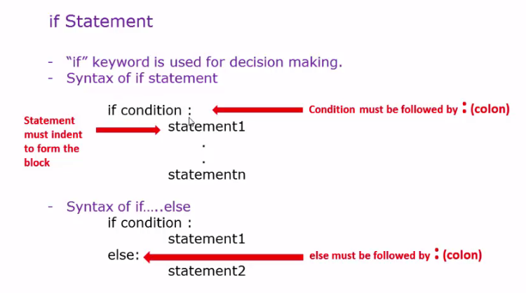
if Statement

Slide 68
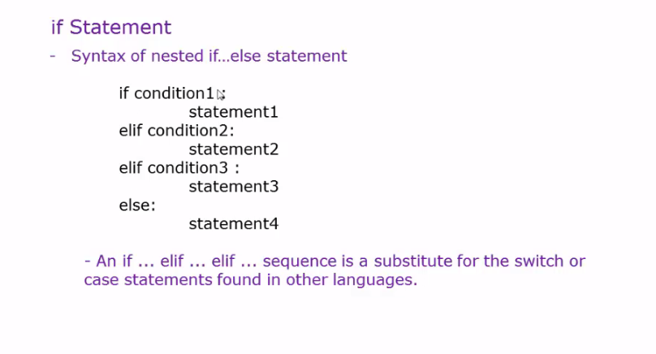
Nested ifelse Statement

Slide 69
Is It
x = 101
if x > 100:
print("x is big")
else:
print("x is small")
print("This will always print")

Slide 70
This works fine
x = 90
if x > 100:
print("x is big")
elif x < 10:
print("x is small")
else:
print("x is medium")

Slide 71
>>> x = 17
>>> if x >= 10 and x <= 20:
... print('x is in the middle')
...
x is in the middle

Slide 72
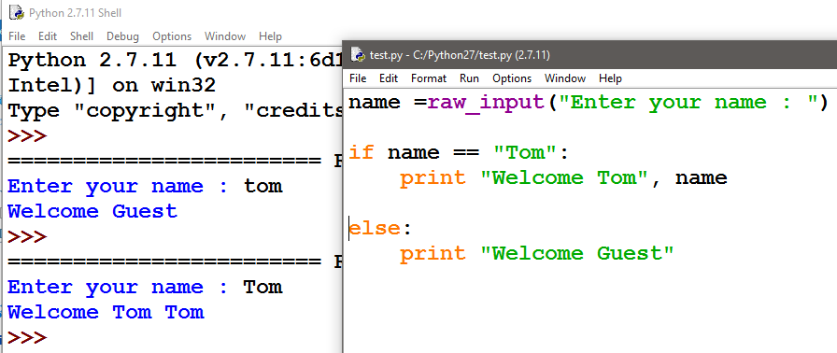

Example :

Slide 73
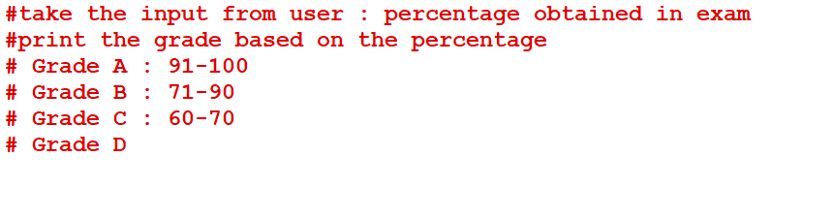
Exercise

Slide 74
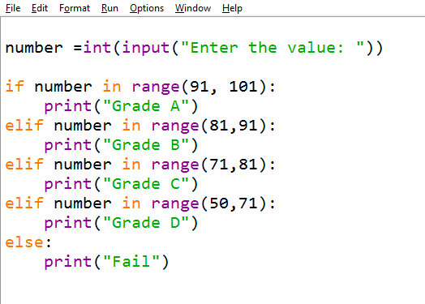

Slide 75
Palindromes

Slide 76
Palindromes Word
Anna
Level
Madam
Malayalam
Refer
Radar
Racecar

Slide 77
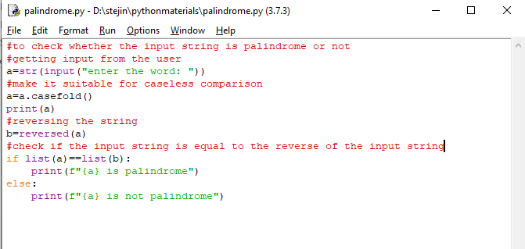
Palindromes Code

Slide 78
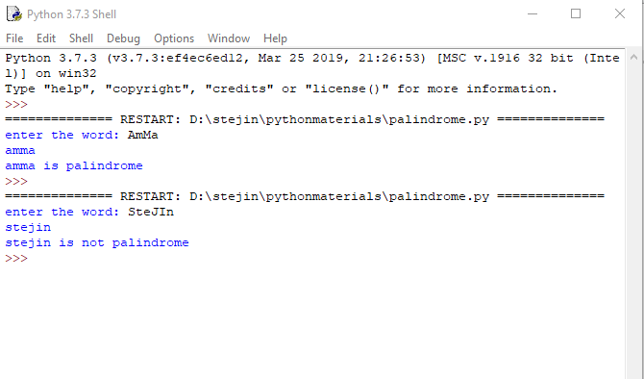
output

Slide 79
Accepting Input from Keyboard(python2)
raw_input
>>> country = raw_input(“Enter the country name :”)
>>> print country
Accepting Input from Keyboard(python3)
Input
>>>country=input(“enter the country name: ”)
>>>print(country)

Slide 80
A FUNCTION FOR ALL
HOW WE ARE DEFINING IN C

Slide 81
WRONG WAY BUT Y?
def count_to_10():
for i in range(1, 11):
print(i)
count_to_10()

Slide 82
def count_to_10():
for i in range(1, 11):
print(i)
count_to_10()

Slide 83
Passing Arguments
def count_to_n(n):
for i in range(1, n + 1):
print(i)
count_to_n(5)

Slide 84
Passing Arguments
def count_to_n(n):
for i in range(1, n + 1):
print(i)
count_to_n(5)

Slide 85
Palindromes With Function

Slide 86
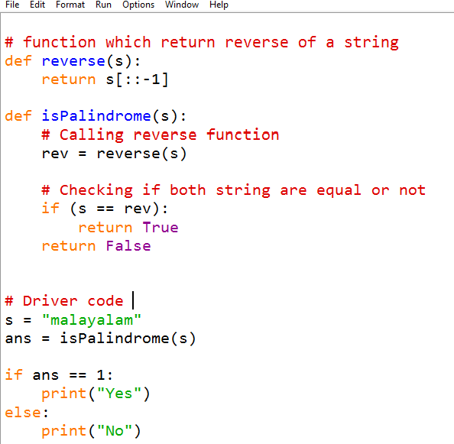
Palindromes with function

Slide 87
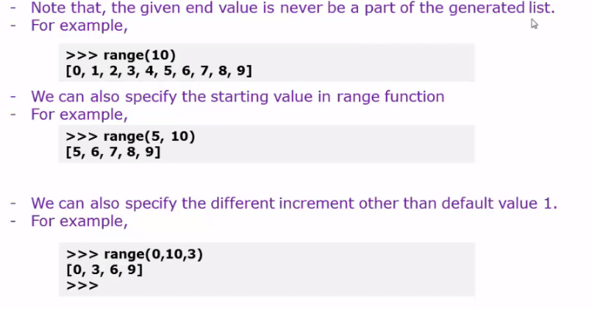
Range Function

Slide 88
For loop
If a sequence contains an expression list, it is evaluated first.
Then, the first item in the sequence is assigned to the iterating variable iterating_var.
Next, the statements block is executed.
Each item in the list is assigned to iterating_var, and the statement(s) block is executed until the entire sequence is exhausted.
Syntax:
for iterating_var in sequence:
statements(s)

Slide 89
Structure of for loop
for itarator_variable in sequence_name:
Statements
. . .
Statements

Slide 90
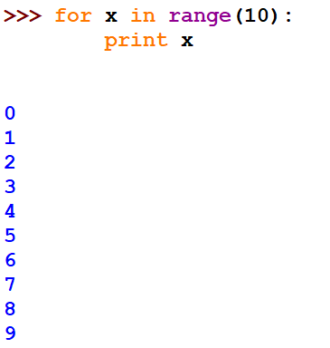
For statement

Slide 91
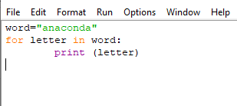
example

Slide 92
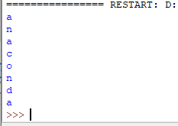
ouput

Slide 93
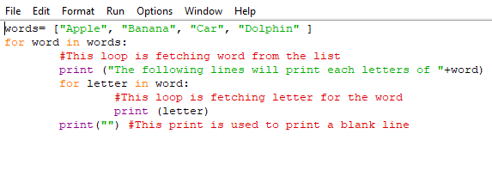
Nested for loop example

Slide 94
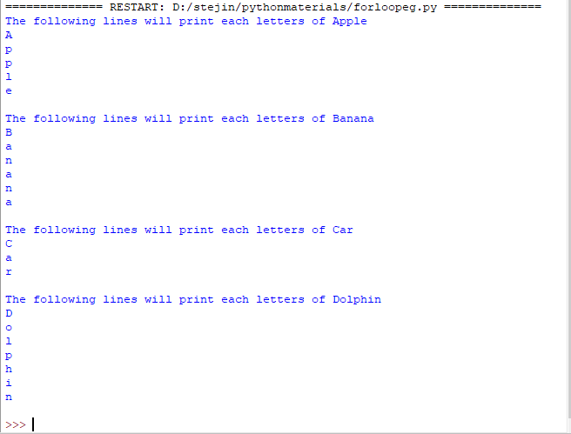
output

Slide 95
exercise
Write a Python program to count the number of even and odd numbers from a series of numbers.
Sample numbers : numbers = (1, 2, 3, 4, 5, 6, 7, 8, 9) Expected Output : Number of even numbers : 5 Number of odd numbers : 4

Slide 96
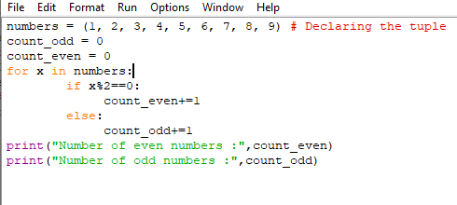
code

Slide 97
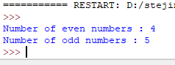
output

Slide 98
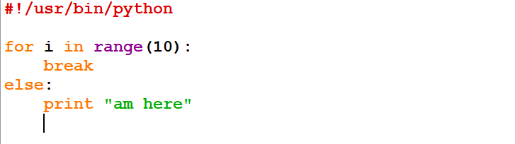
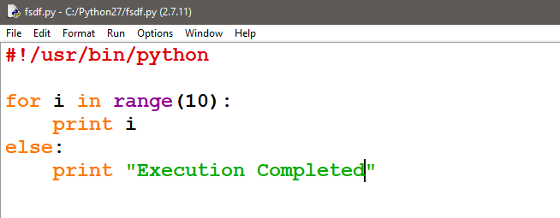
else clause in loop:

Slide 99
DOUBTS:

Slide 100
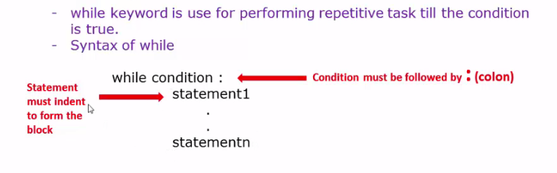
While loop

Slide 101
Structure of while loop
While condition :
#Start of the statements
Statement
. . . . . . .
Statement
#End of the Statements
else :
#this scope is optional
#This statements will be executed if the condition
#written to execute while loop is false

Slide 102
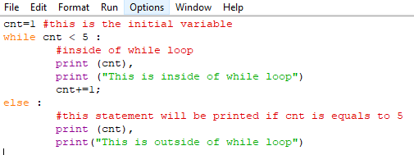
While loop example

Slide 103
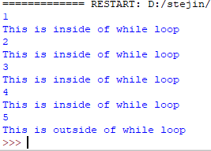
output

Slide 104
exercise
Write a Python program to get the Fibonacci series between 0 to 50
Note : The Fibonacci Sequence is the series of numbers : 0, 1, 1, 2, 3, 5, 8, 13, 21, .... Every next number is found by adding up the two numbers before it. Expected Output : 1 1 2 3 5 8 13 21 34

Slide 105
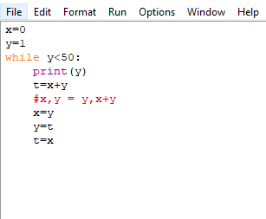
code

Slide 106
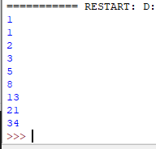
output

Slide 107
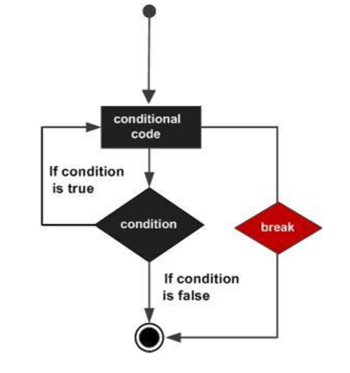
Break Statement

Slide 108
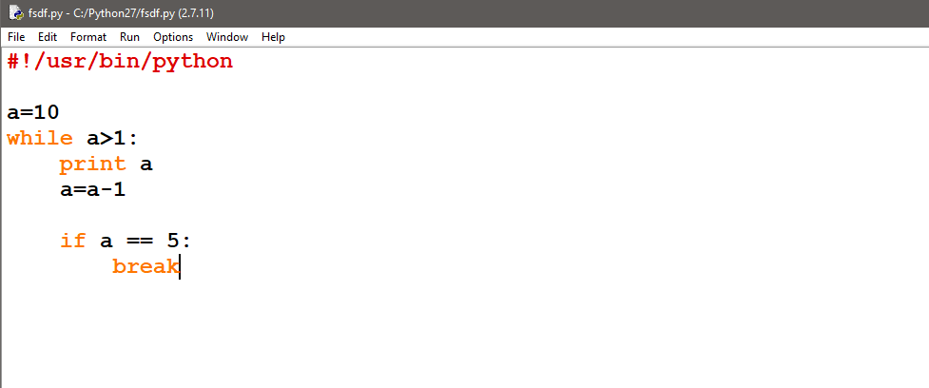
Example:

Slide 109
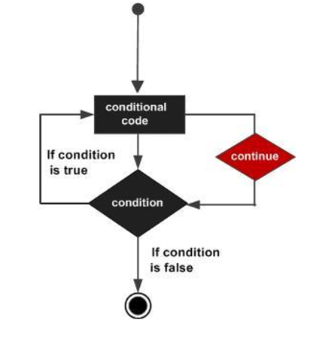
Continue Statement

Slide 110
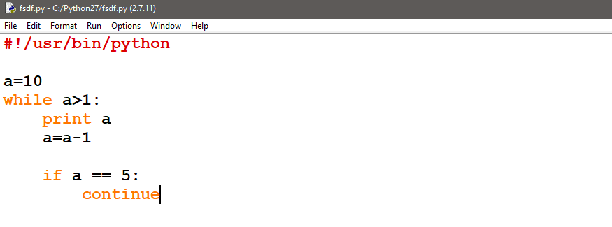
Example:

Slide 111
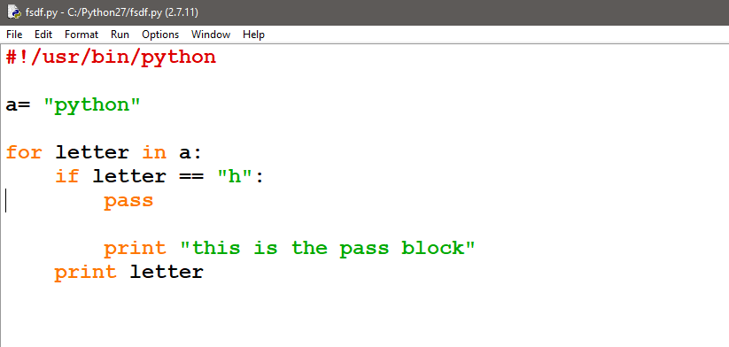
Pass Statement
Example:

Slide 112
Data Structures
List
Tuple

Slide 113
Python Lists
List = [‘abcd’ , 786 , 2.23, ‘python’, 70.2]
print List
print List[0]
print List[1:3]
print List[2:]

Slide 114
Methods of List
A= [10,30,40,50]
list.insert(position, element) ex: a.insert(2,20)
list.append(element) ex: a.append(200)
list.remove(element) ex: a.remove(200)
list. reverse() ex: a.reverse()

Slide 115
Methods of list
append() Adds an element at the end of the list
clear() Removes all the elements from the list
copy() Returns a copy of the list
count() Returns the number of elements with the specified value
extend() Add the elements of a list (or any iterable), to the end of the current list
index() Returns the index of the first element with the specified value
insert() Adds an element at the specified position
pop() Removes the element at the specified position
remove() Removes the first item with the specified value
reverse() Reverses the order of the list
sort() Sorts the list

Slide 116
exercise
Write a Python program to get the largest number from a list.
A=[1,-2,-6,3,9]
Largest number in the list is 9

Slide 117
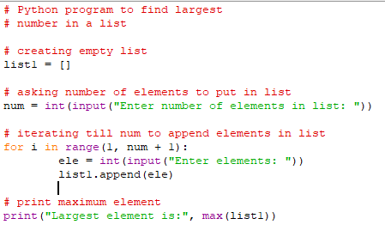
code

Slide 118
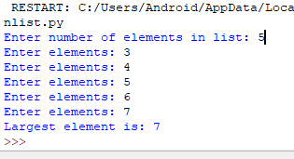
output

Slide 119
Python Tuples
Read only cannot be updated
Tuple=(123, ‘python’,78.12)
print Tuple
print Tuple[:2]

Slide 120
len((1, 2, 3))
(1, 2, 3) + (4, 5, 6)
('Hi!',) * 4
Repetition
3 in (1, 2, 3) True Membership
for x in (1, 2, 3): print x, 1 2 3 Iteration

Slide 121
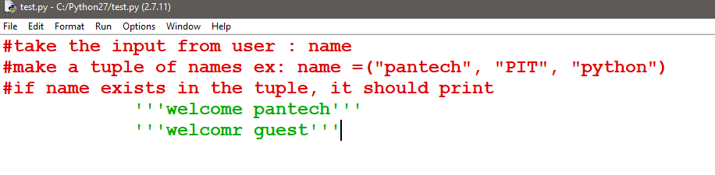
Exercise

Slide 122
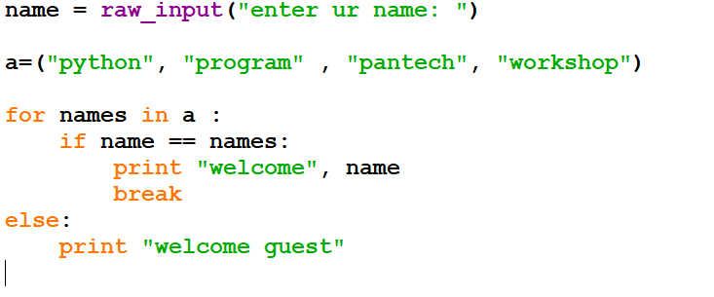
Example:

Slide 123

code

Slide 124

output

Slide 125
Function
A function is a block of organized, reusable code that is used to perform a single or related tasks.
Python gives in-built functions like print() , you can make your own function also and this are called user-defined-functions
Function blocks begin with the keyword def followed by the function name and parentheses ( ( ) ).

Slide 126
Stored (and reused) Steps
def
Program:
def thing():
print 'Hello’
print 'Fun’
thing()
print 'Zip’
thing()
hello():
print 'Hello'
Output:
Hello
Fun
Zip
Hello
Fun
print 'Fun'
hello()
print “Zip”
hello()
We call these reusable pieces of code “functions”.

Slide 127
Python Functions
There are two kinds of functions in Python.
Built-in functions that are provided as part of Python - raw_input(), type(), float(), int() ...
Functions that we define ourselves and then use
We treat the of the built-in function names as "new" reserved words (i.e. we avoid them as variable names)

Slide 128
Function Definition
In Python a function is some reusable code that takes arguments(s) as input does some computation and then returns a result or results
We define a function using the def reserved word
We call/invoke the function by using the function name, parenthesis and arguments in an expression

Slide 129
Argument
big = max('Hello world')
Assignment
'w'
Result
>>> big = max('Hello world')
>>> print bigw>>> tiny = min('Hello world')
>>> print tiny>>>

Slide 130
Max Function
A function is some stored code that we use. A function takes some input and produces an output.
>>> big = max('Hello world')
>>> print big'w'
max()
function
“Hello world”
(a string)
‘w’
(a string)
Guido wrote this code

Slide 131
Max Function
A function is some stored code that we use. A function takes some input and produces an output.
>>> big = max('Hello world')
>>> print big'w'
def max(inp):
blah
blah
for x in y:
blah
blah
“Hello world”
(a string)
‘w’
(a string)
Guido wrote this code

Slide 132
Type Conversions
>>> print float(99) / 100
0.99
>>> i = 42
>>> type(i)
<type 'int'>
>>> f = float(i)
>>> print f
42.0
>>> type(f)
<type 'float'>
>>> print 1 + 2 * float(3) / 4 - 5
-2.5
>>>
When you put an integer and floating point in an expression the integer is implicitly converted to a float
You can control this with the built in functions int() and float()

Slide 133
String Conversions
>>> sval = '123'
>>> type(sval)
<type 'str'>
>>> print sval + 1
Traceback (most recent call last):
File "<stdin>", line 1, in <module>
TypeError: cannot concatenate 'str' and 'int'
>>> ival = int(sval)
>>> type(ival)
<type 'int'>
>>> print ival + 1
124
>>> nsv = 'hello bob'
>>> niv = int(nsv)
Traceback (most recent call last):
File "<stdin>", line 1, in <module>
ValueError: invalid literal for int()
You can also use int() and float() to convert between strings and integers
You will get an error if the string does not contain numeric characters

Slide 134
Building our Own Functions
We create a new function using the def keyword followed by optional parameters in parenthesis.
We indent the body of the function
This defines the function but does not execute the body of the function
def print_lyrics():
print "I'm a lumberjack, and I'm okay.”
print 'I sleep all night and I work all day.'

Slide 135
print "I'm a lumberjack, and I'm okay."
print 'I sleep all night and I work all day.'
print_lyrics():
x = 5
print 'Hello'
def print_lyrics():
print "I'm a lumberjack, and I'm okay.”
print 'I sleep all night and I work all day.'
print 'Yo'
x = x + 2
print x
Hello
Yo
7

Slide 136
Definitions and Uses
Once we have defined a function, we can call (or invoke) it as many times as we like
This is the store and reuse pattern

Slide 137
x = 5
print 'Hello'
def print_lyrics():
print "I'm a lumberjack, and I'm okay.”
print 'I sleep all night and I work all day.'
print 'Yo'
print_lyrics()
x = x + 2
print x
Hello
Yo
I'm a lumberjack, and I'm okay.I sleep all night and I work all day.
7

Slide 138
Arguments
An argument is a value we pass into the function as its input when we call the function
We use arguments so we can direct the function to do different kinds of work when we call it at different times
We put the arguments in parenthesis after the name of the function
big = max('Hello world')
Argument

Slide 139
Parameters
>>> def greet(lang):
... if lang == 'es':
... print 'Hola’
... elif lang == 'fr':
... print 'Bonjour’
... else:
... print 'Hello’
...
>>> greet('en')Hello
>>> greet('es')Hola
>>> greet('fr')Bonjour
>>>
A parameter is a variable which we use in the function definition that is a “handle” that allows the code in the function to access the arguments for a particular function invocation.

Slide 140
Return Values
Often a function will take its arguments, do some computation and return a value to be used as the value of the function call in the calling expression. The return keyword is used for this.
def greet():
return "Hello”
print (greet(), "Glenn”)
print (greet(), "Sally“)
Hello Glenn
Hello Sally

Slide 141
Return Value
>>> def greet(lang):
... if lang == 'es':
... return 'Hola’
... elif lang == 'fr':
... return 'Bonjour’
... else:
... return 'Hello’
... >>> print greet('en'),'Glenn’
Hello Glenn
>>> print greet('es'),'Sally’
Hola Sally
>>> print greet('fr'),'Michael’
Bonjour Michael
>>>
A “fruitful” function is one that produces a result (or return value)
The return statement ends the function execution and “sends back” the result of the function

Slide 142
Arguments, Parameters, and Results
>>> big = max('Hello world')
>>> print big'w'
Parameter
def max(inp):
blah
blah
for x in y:
blah
blah
return ‘w’
“Hello world”
‘w’
Argument
Result

Slide 143
Multiple Parameters / Arguments
We can define more than one parameter in the function definition
We simply add more arguments when we call the function
We match the number and order of arguments and parameters
def addtwo(a, b):
added = a + b
return added
x = addtwo(3, 5)
print x

Slide 144
Void (non-fruitful) Functions
When a function does not return a value, we call it a "void" function
Functions that return values are "fruitful" functions
Void functions are "not fruitful"

Slide 145
To function or not to function...
Organize your code into “paragraphs” - capture a complete thought and “name it”
Don’t repeat yourself - make it work once and then reuse it
If something gets too long or complex, break up logical chunks and put those chunks in functions
Make a library of common stuff that you do over and over - perhaps share this with your friends...

Slide 146
Exercise
Rewrite your pay computation with time-and-a-half for overtime and create a function called computepay which takes two parameters ( hours and rate).
Enter Hours: 45
Enter Rate: 10
Pay: 475.0
475 = 40 * 10 + 5 * 15

Slide 147


Slide 148
Summary
Functions
Built-In Functions
Type conversion (int, float)
Math functions (sin, sqrt)
Try / except (again)
Arguments
Parameters

Slide 149


